Slide 1
Performance of Project-Based Effective Learning
Roadway Safety Problem
43 Students
2/3 Persons Group
8 Elementary Schools in/around Jonesboro
Questions
Pre-test
Traditional Learning
Post-test
Active Learning
Hypothesis: Students’ learning is expected to improve through collaborative environment
Investigator: Dr. Zahid Hossain, P.E.
Associate Professor of Civil Engineering

Slide 2
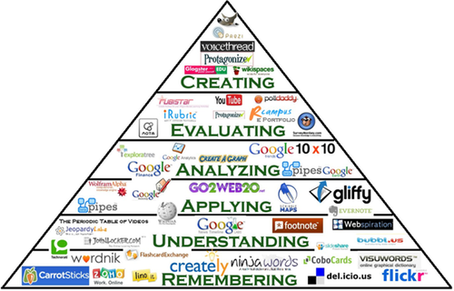
Objectives:
Analyze data using Bloom’s Taxonomy (Memorize, Understand, Analyze, and Apply)
Use students’ reports to assess ABET Outcome No. 4. Students should be able to identify, formulate and solve engineering problems
Bloom’s Taxonomy

Slide 3
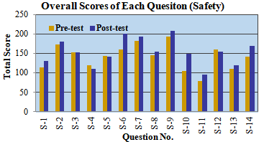
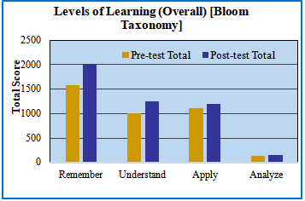
Results
Students’ learning improved in most questions- Hypothesis is true
Per Bloom’s Taxonomy
Students’ learning increased in all four learning categories
Significant increase in Remember, Understand and Apply questions
Slight increase in Analyze questions.
Learning did not vary significantly (@95% confidence) between groups.

Slide 4
Acknowledgments:
A-State Office of the Assessment Program for the Mini grant
Transportation classes and former GA (Shahriar Alam)

